Slide 1


Credit card fraud detection by using machine learning and neural networking
Final delivery Execution and Interpretation
Fitsum Desalegn
Data606
Aug, 10, 2020

Slide 2
Recap
https://www.kaggle.com/mlg-ulb/creditcardfraud
The datasets contains transactions made by credit cards in September 2013 by European cardholders
Goal of the project - To find out the best accuracy result before the transaction is approved
Algorithms under project are
Logistic regression
Random forests
Artificial neural networks
Literature review
Credit card fraud detection with random forests
Credit card fraud detection with CNNs
Detecting credit card fraud with machine learning

Slide 3
Exploratory data Analysis Result
EDA was performed with multiple plots on the relation of input features and their distribution.
Data preprocessing was performed with Pandas and Pytorch
A window size of 64 was chosen and can be changed for further studies.
The data contains only numerical input variables with non missing values

Slide 4
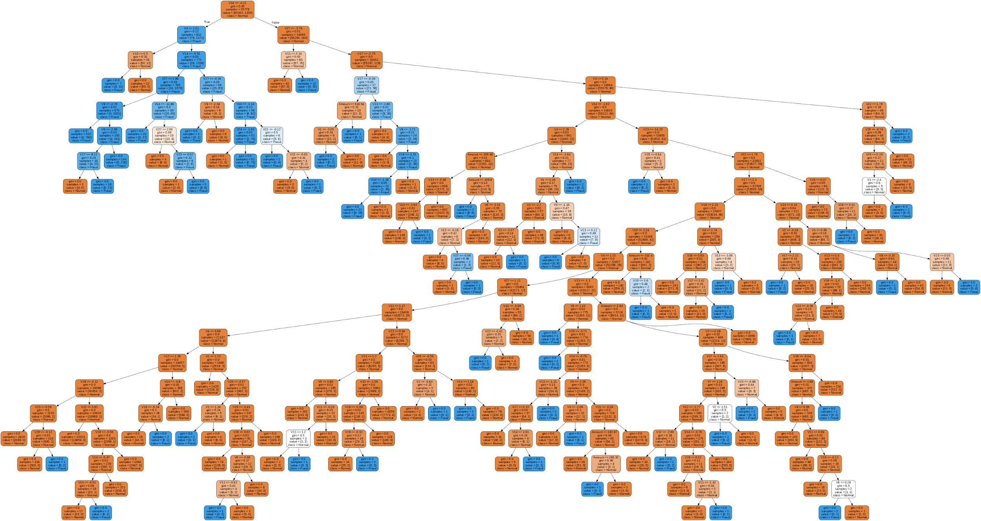
Modelling - Logistic regression and Random forests
Credit card fraudulent transactions identification can be posed as binary classification problem.
Logistic regression and random forests can be used to predict normal and fraudulent transactions based on the dataset provided
Sklearn library was used to implement these two models.
10 decision trees were used to create the random forest model with gini score as the information metric
L2 loss was considered in the case of logistic regression

Slide 5
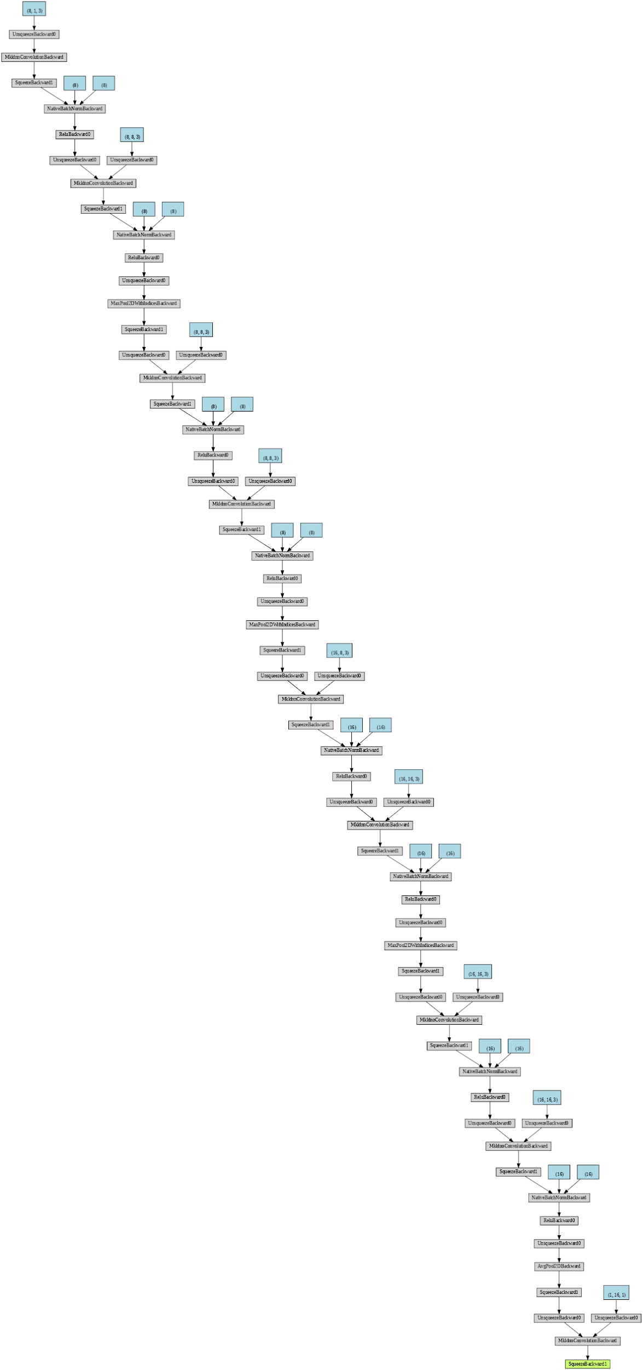
Modelling - ANNs
ANNs were implemented with the help of Pytorch library
Convolutional neural networks were used to address the problem.
They were trained for 30 epochs with binary cross entropy loss for classification

Slide 6
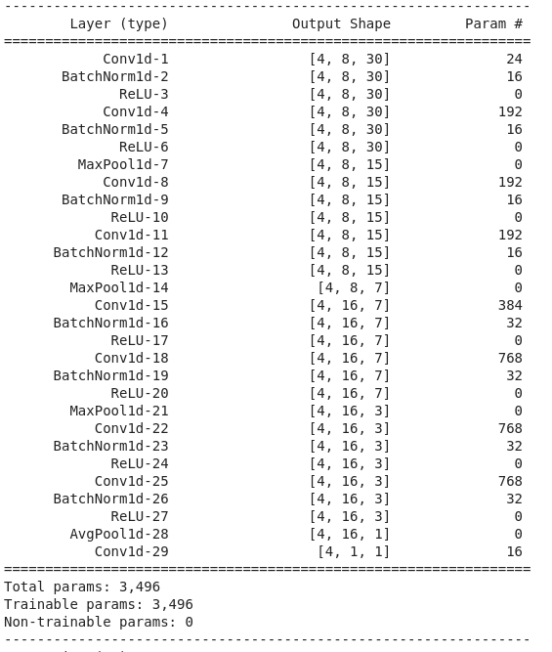
Modelling - ANNs
The network has 29 layers and a total trainable parameters over 3000
Due to high class imbalance weighted loss function was used for training.
K fold testing with K = 3 was used to test performance.

Slide 7
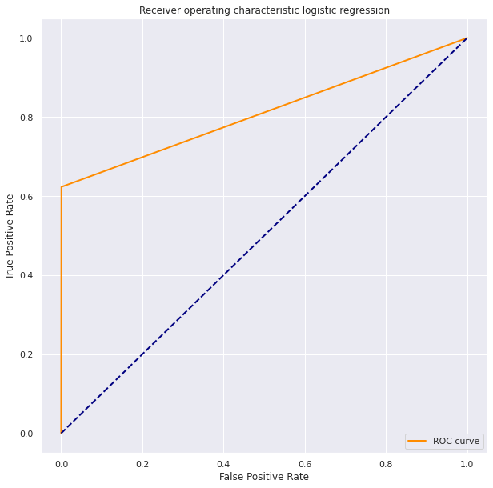
Model performance
Logistic regression
High accuracy 96%
Low recall 62%
Low complexity
Highly interpretable
No much scalable according to data

Slide 8
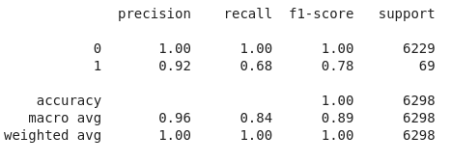
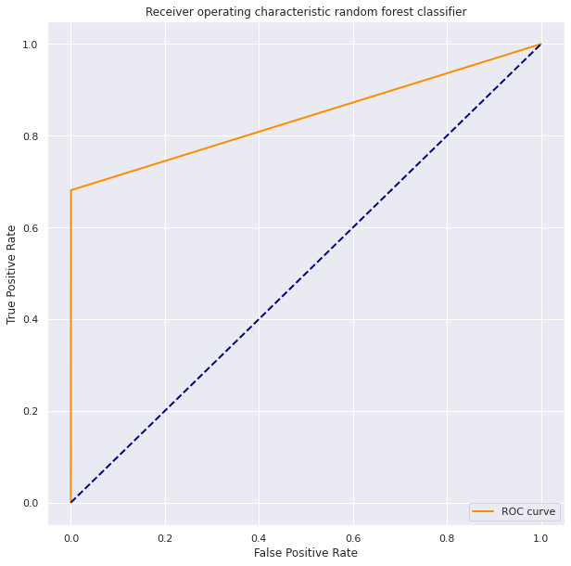
Model performance
Random forests
High accuracy 99%
Moderate recall 68%
Moderate complexity
Medium interpretable
Works well on larger datasets also

Slide 9
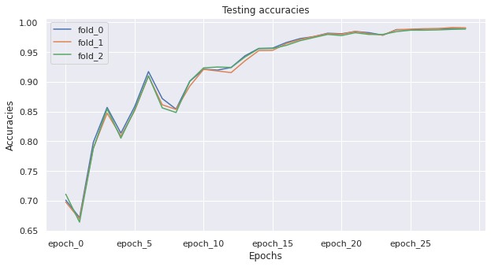
Model performance
Artificial neural networks
High accuracy 94.8%
High recall 97.3%
High complexity
Low interpretability
Works well on large datasets

Slide 10
Improvements can be done on the existing project
Different loss functions for logistic regression can be implemented
The number of decision trees can be increased to see the performance of random forests.
The CNN architecture and learning strategy can be experimented with to provide further insights.
A random up/down sampling of the complete dataset can be done to handle class imbalance before training.

Slide 11
Conclusion
There is problem to solve the high class imbalance in datasets
If a quick and dirty solution to the problem is expected, logistic regression can be adopted.
Random forests can be used to solve the problem
If the quantity of data is very high with good computational resources available to predict fraud detection,
ANNs can be used to scale into complicated models with good recall scores.

Slide 12

f72@umbc.edu
https://github.com/fitsum99/DATA606/tree/master/Delivery%202

